Slide 1
2023/2024
Computational Methods for Finance
Python - Basics I
Dr. Yang Yue

Slide 2
Learning Outcomes
After this lecture, you will be able to:
Understand what is Python and appreciate its roles in financial industry
Understand Python deployments and tools.
Deploy Python by downloading and install Anaconda.

Slide 3
Python and Finance

Slide 4
Python and Finance
Python
Python is a high-level, multipurpose programming language that is used in a wide range of domains and technical fields.
‘Python is an interpreted, object-oriented, high-level programming language with dynamic semantics. Python’s simple, easy to learn syntax emphasizes readability and therefore reduces the cost of program maintenance. Python supports modules and packages, which encourages program modularity and code reuse. The Python interpreter and the extensive standard library are available in source or binary form without charge for all major platforms, and can be freely distributed.’
Nowadays, Python is used by the beginner programmer as well as by the highly skilled expert developer in universities, at web companies, in large corporations and financial institutions, as well as in any scientific field.

Slide 5
Python
Among other features, Python is:
Open source
  Python and the majority of supporting libraries and tools available are open source and generally come with quite flexible and open licenses.
Interpreted
  The reference CPython implementation is an interpreter of the language that translates Python code at runtime to executable byte code.
Multiparadigm
  Python supports different programming and implementation paradigms, such as object orientation and imperative, functional, or procedural programming.
Multipurpose
  Python can be used for rapid, interactive code development as well as for building large applications; it can be used for low-level systems operations as well as for high-level analytics tasks.
Cross-platform
  Python is available for the most important operating systems, such as Windows, Linux, and Mac OS; it is used to build desktop as well as web applications; it can be used on the largest clusters and most powerful servers as well as on such small devices as the Raspberry Pi (cf. http://www.raspberrypi.org).
Dynamically typed
  Types in Python are in general inferred during runtime and not statically declared as in most compiled languages.
Indentation aware
  In contrast to the majority of other programming languages, Python uses indentation for marking code blocks instead of parentheses, brackets, or semicolons.
Garbage collecting
  Python has automated garbage collection, avoiding the need for the programmer to manage memory.

Slide 6
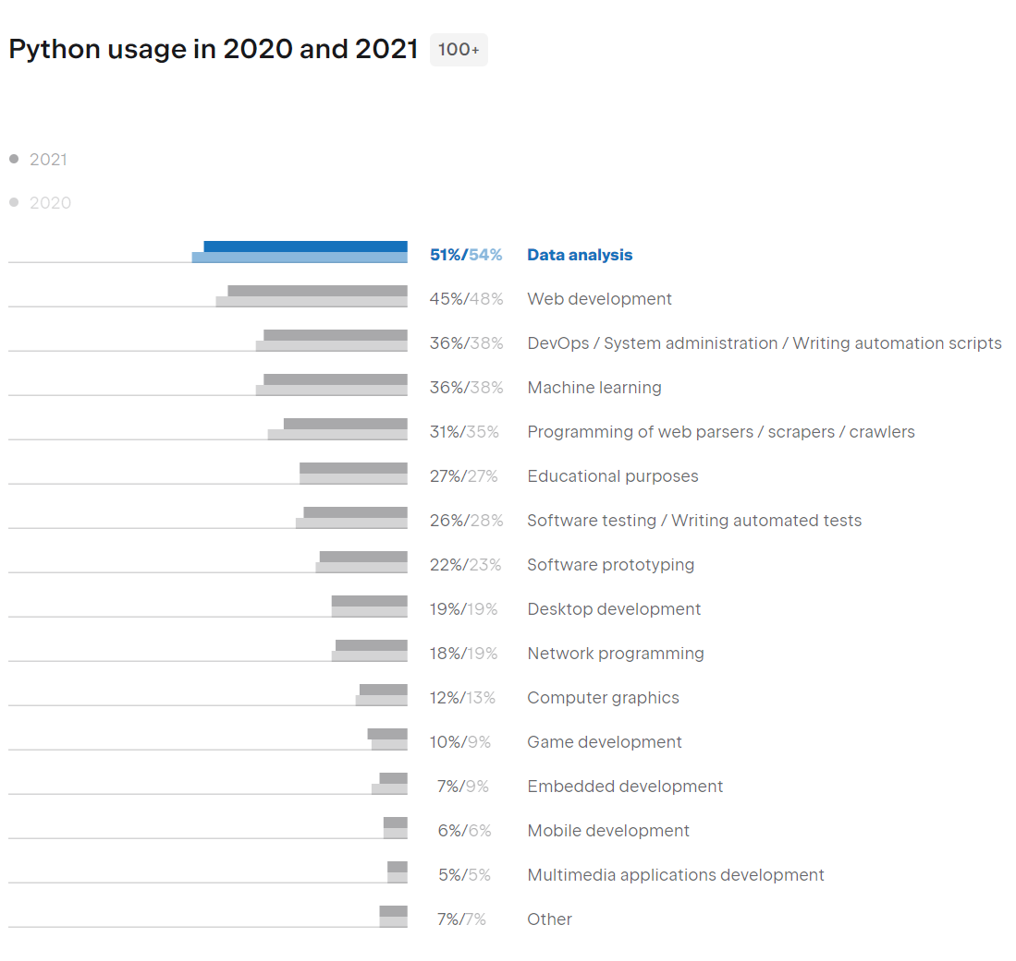
Python and Finance
Python for Finance
In recent years, spurred by innovation and also regulation, banks and other financial institutions like hedge funds have evolved more and more into technology companies instead of being just financial intermediaries. Technology has become a major asset for almost any financial institution around the globe, having the potential to lead to competitive advantages as well as disadvantages. Some background information can shed light on the reasons for this development. (https://www.netguru.com/blog/python-in-finance)
Python developers survey (https://lp.jetbrains.com/python-developers-survey-2021/#Demographics):
‘For the last 4 years the share of developers who use Python as their main language remains at the pretty same level of 84-85%.’
Python has been ranked the most popular language in IEEE Spectrum (https://spectrum.ieee.org/the-top-programming-languages-2023)

Slide 7
Deploying Python

Slide 8
Python and Finance
Anaconda IDE
Download and Install the anaconda from its official website. https://www.anaconda.com/
Follow the tips on https://docs.anaconda.com/anaconda/install/
Choose the Individual Edition.
Double click the installer to launch.
Select an install for “Just Me”.
Select a destination folder to install Anaconda and click the Next button.
Choose whether to add Anaconda to your PATH environment variable. We recommend not adding Anaconda to the PATH environment variable, since this can interfere with other software. Instead, use Anaconda software by opening Anaconda Navigator or the Anaconda Prompt from the Start Menu.
After a successful installation you will see the “Thanks for installing Anaconda” dialog box.

Slide 9
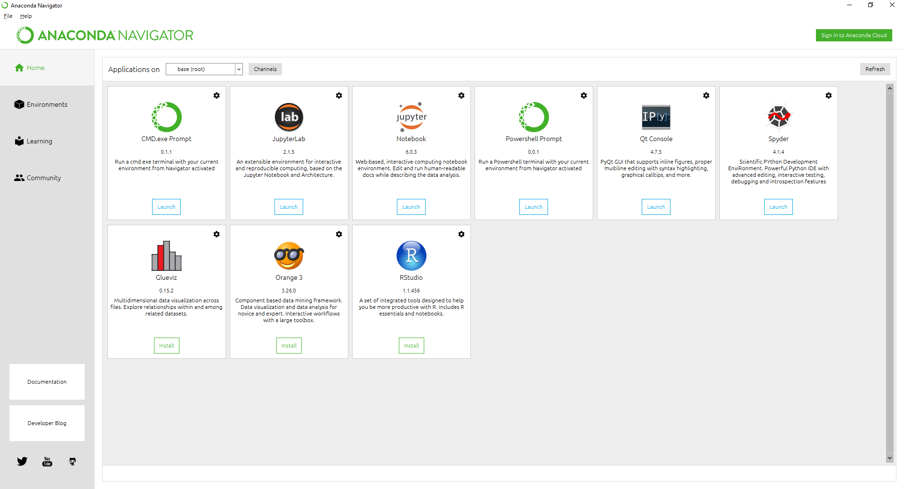
Python and Finance
Anaconda IDE
Jupyter Notebook
The Jupyter Notebook interface is a Web-based application for authoring documents that combine live-code with narrative text, equations and visualizations.
Spyder
Spyder is a powerful scientific environment written in Python, for Python, and designed by and for scientists, engineers and data analysts. It features a unique combination of the advanced editing, analysis, debugging, and profiling functionality of a comprehensive development tool with the data exploration, interactive execution, deep inspection, and beautiful visualization capabilities of a scientific package.

Slide 10
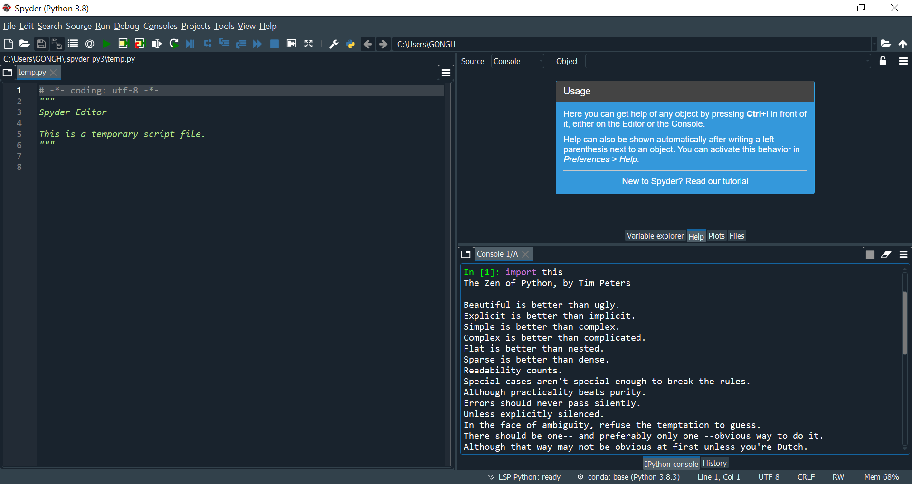
Python and Finance
Spyder
Click On the Launch button for Spyder available in your Anaconda Prompt .
Left Side of the screen — Place where you type your code.
Top Right Side of the screen — Place where you play around with your files and explore your output. You could also use Help menu to discover your syntax
Bottom Right Side of the screen — Place where you see your Output.

Slide 11
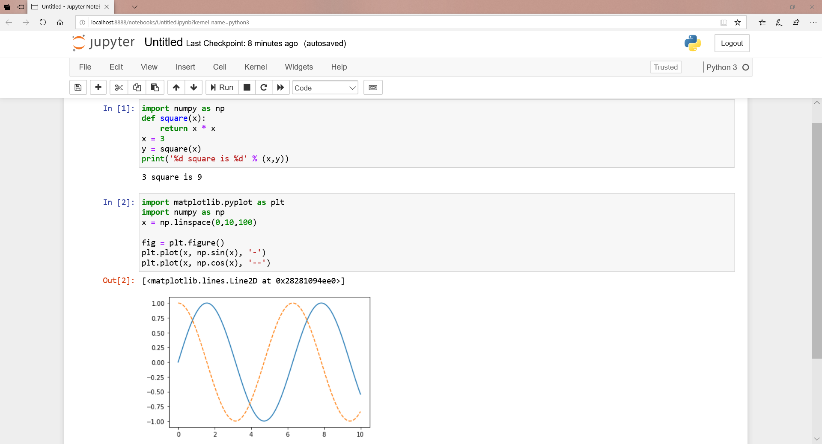
Python and Finance
Jupyter Notebook
import numpy as np
def square(x):
return x * x
x = 3
y = square(x)
print('%d square is %d' % (x,y))
import matplotlib.pyplot as plt
import numpy as np
x = np.linspace(0,10,100)
fig = plt.figure()
plt.plot(x, np.sin(x), '-')
plt.plot(x, np.cos(x), '--')

Slide 12
Reading
Chapter 1, 2 in Hipisch (2014)

